Slide 1
Vibrations & Sound Waves
Singing Spoons

Slide 2

Did you know that when we hear something, we are just experiencing vibrations in the air? It takes three types of vibrations to work together for us to hear sound. The process begins with the object that is creating the sound. The first vibration occurs as the object makes noise. The second vibration occurs as the sound moves through the air. Air molecules simply get out of the way as the vibration travels to our ears. As the sound wave travels it causes the air molecules to vibrate. The last vibration occurs when the sound wave reaches our us our eardrum resulting in our eardrums vibrating as well.
In the following activity, you’ll use metal spoons to create amazing noises that sounds like bells or gongs chiming – but you’ll only hear these incredible sounds if you put your fingers in your ears! When the spoons swing and bang together, the metal flexes a tiny amount, and then flexes back again repeatedly. These movements, known as vibrations, are too fast and small to see, but they cause the string attached to the spoon to vibrate as well. These vibrations pass along the string and ultimately into your ears!

Slide 3

Difficulty
Time
EASY
MEDIUM
HARD

Slide 4
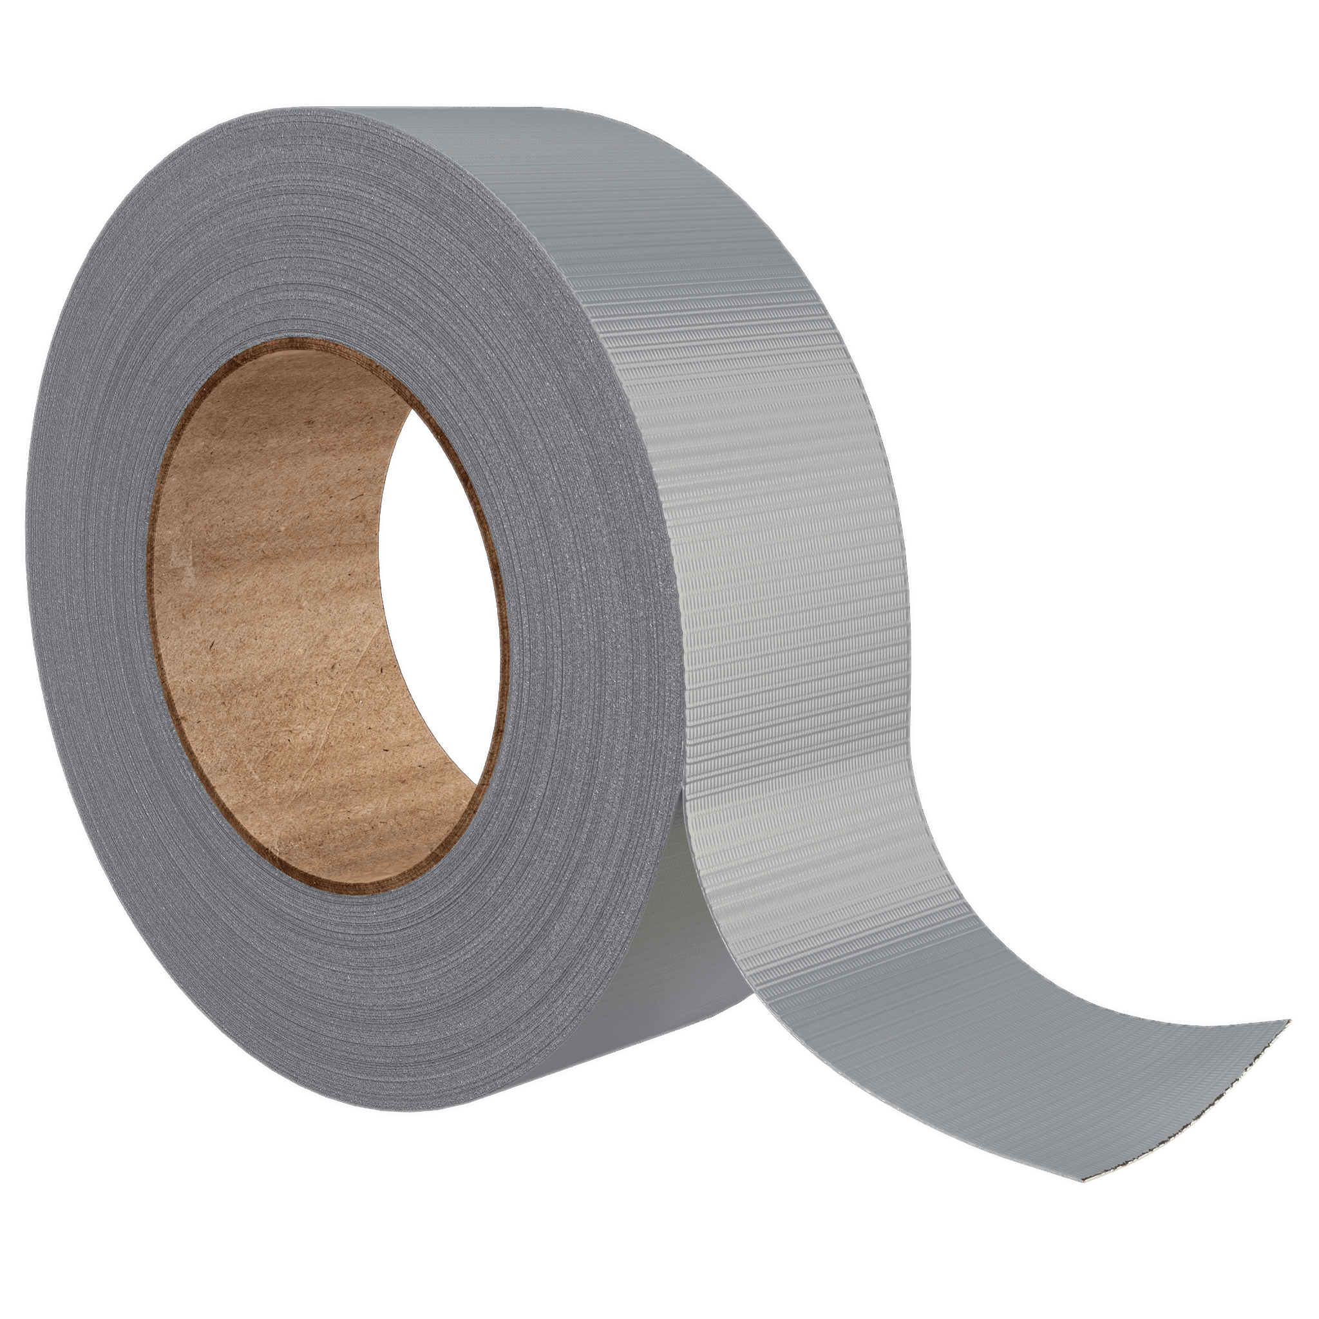
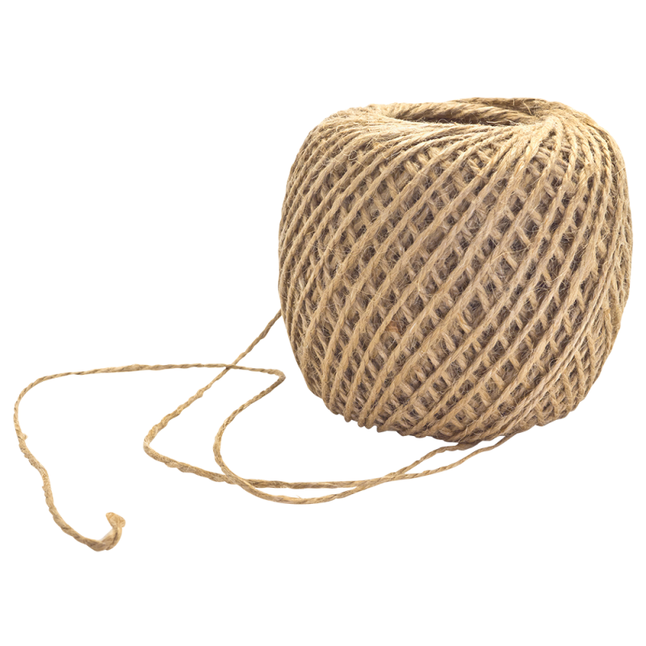
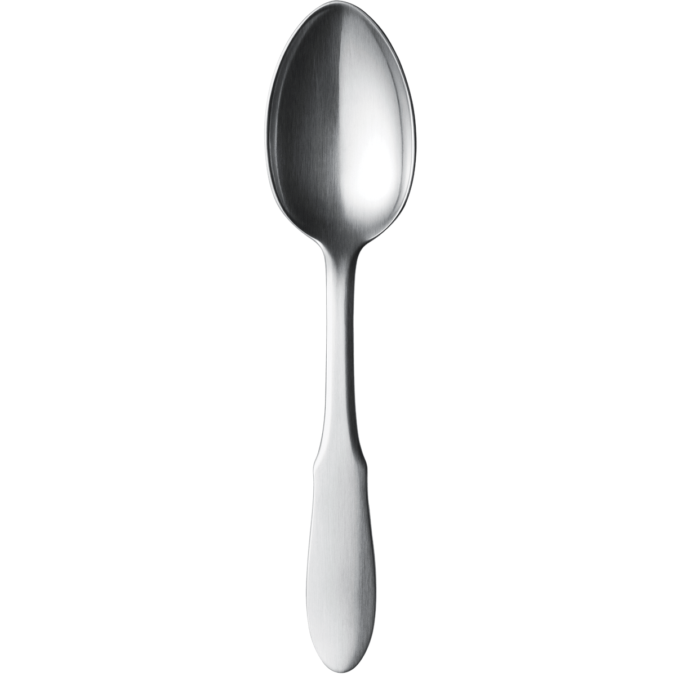
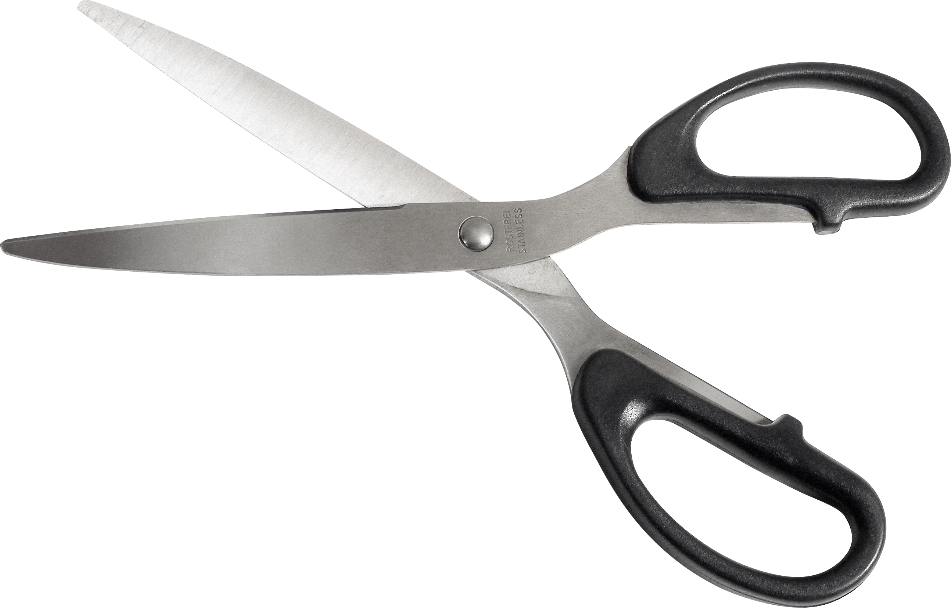
Materials
Tape
String
Scissors
3 Spoons

Slide 5
STEpS
Now that we have our materials let’s create something Awesome

Slide 6
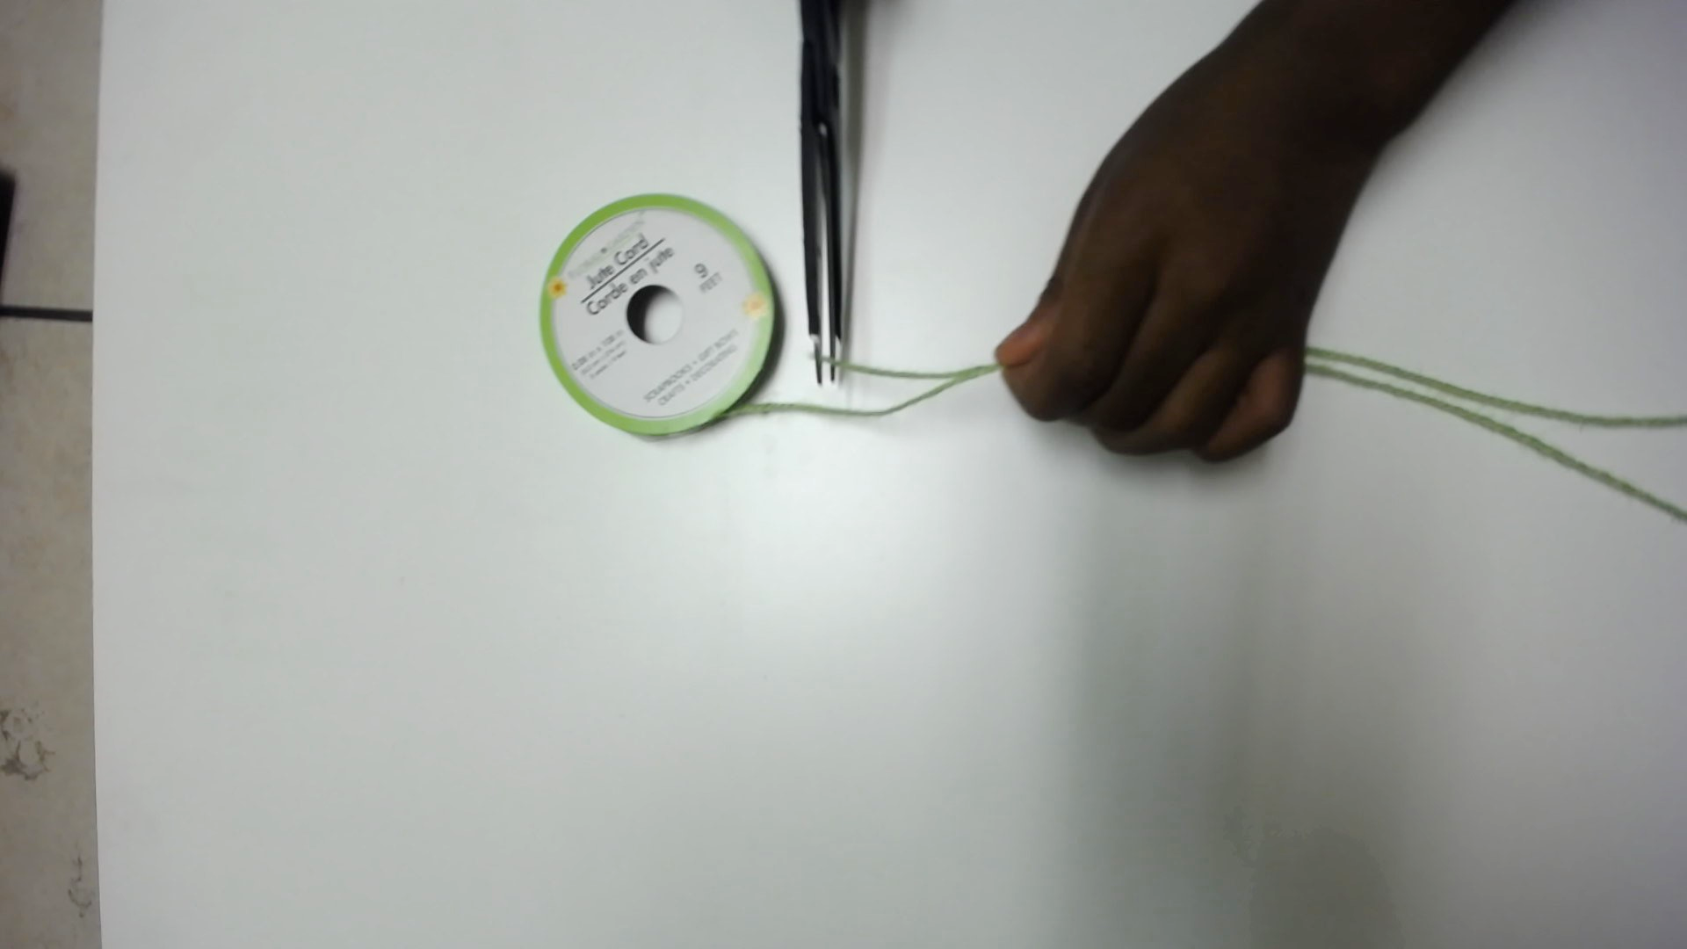
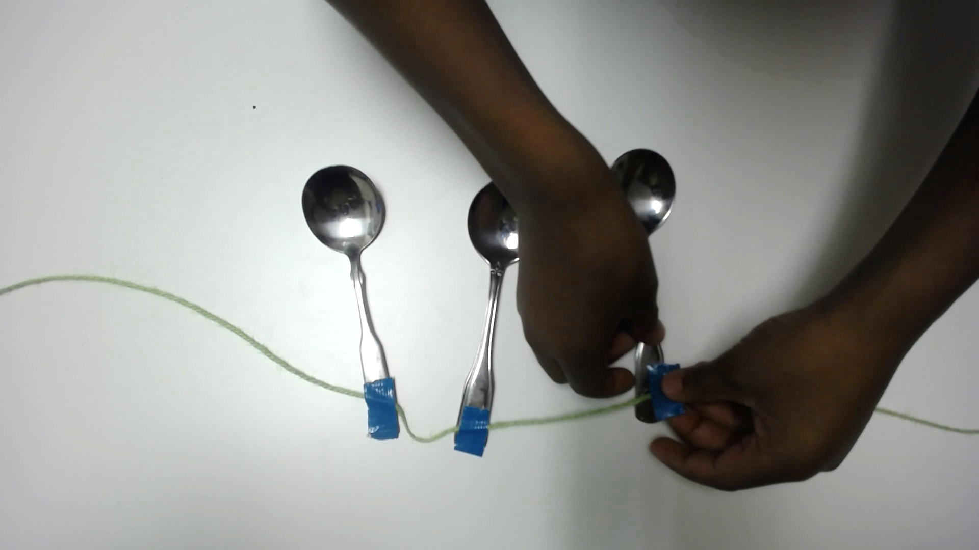
Step 1
Cut a piece of string that is about the length of your arm and lay it flat on the table.
Step 2
At the string’s middle point, place the ends of the spoons about an inch apart. Secure each spoon to the string with a piece of tape.

Slide 7
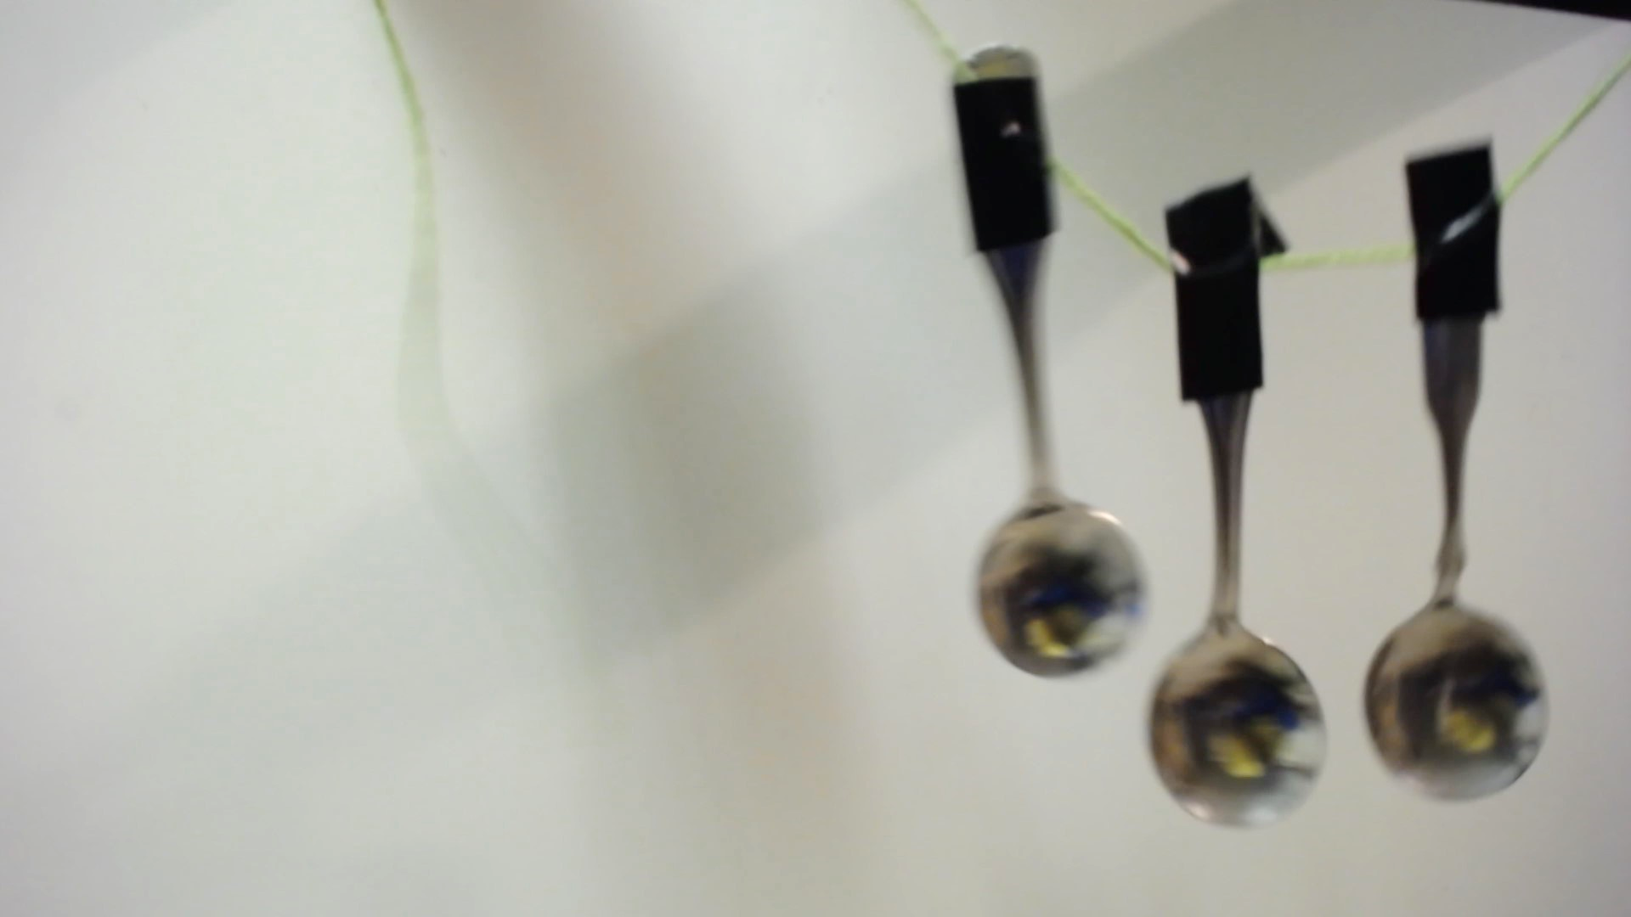
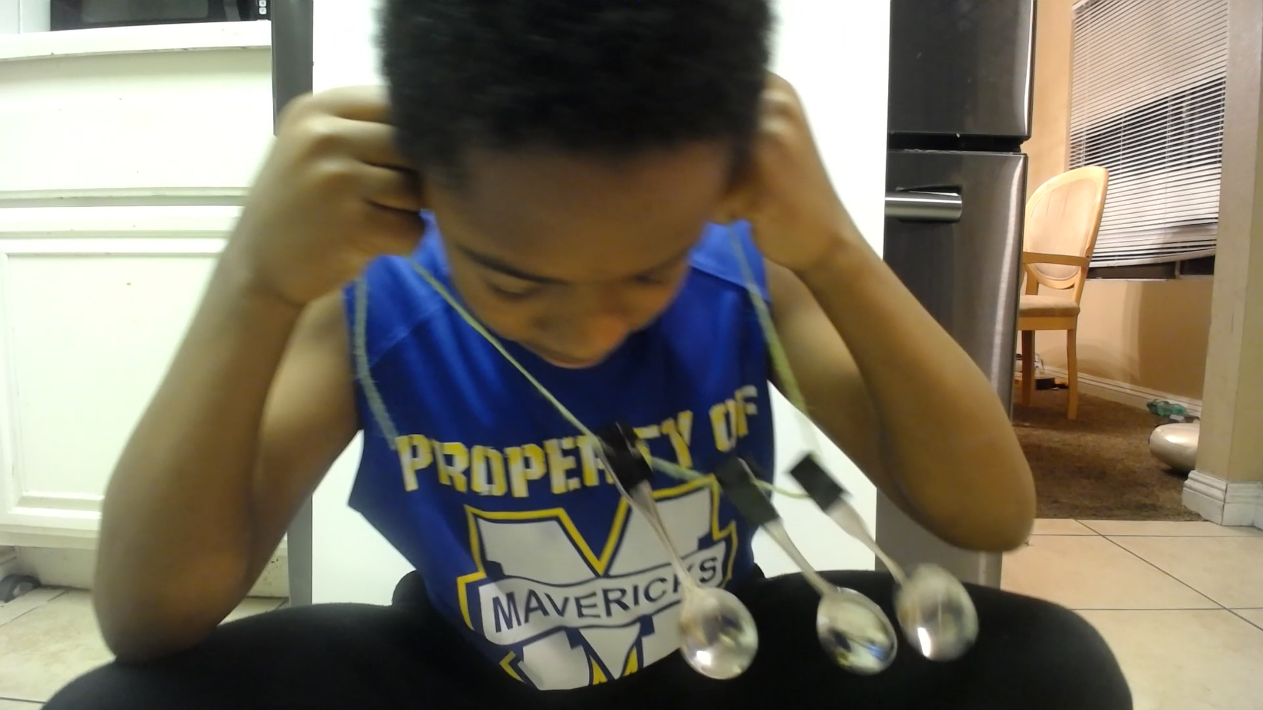
Step 3
Dangle the spoons in front of you and wrap the string around one finger of each hand. Knock the spoons together – they’ll make a sharp, tinny sound.
Step 4
Put both fingers in your ears (with string still wrapped around your fingers). Shake the spoons so they knock against each other. The spoons will sound louder and richer, like bells chiming.

Slide 8
Test & Tweak
If you switch the metal spoons for other metal objects, such as keys or nuts and bolts, how does the sound change?
Does the experiment still work if you use wooden or plastic spoons instead?

Slide 9
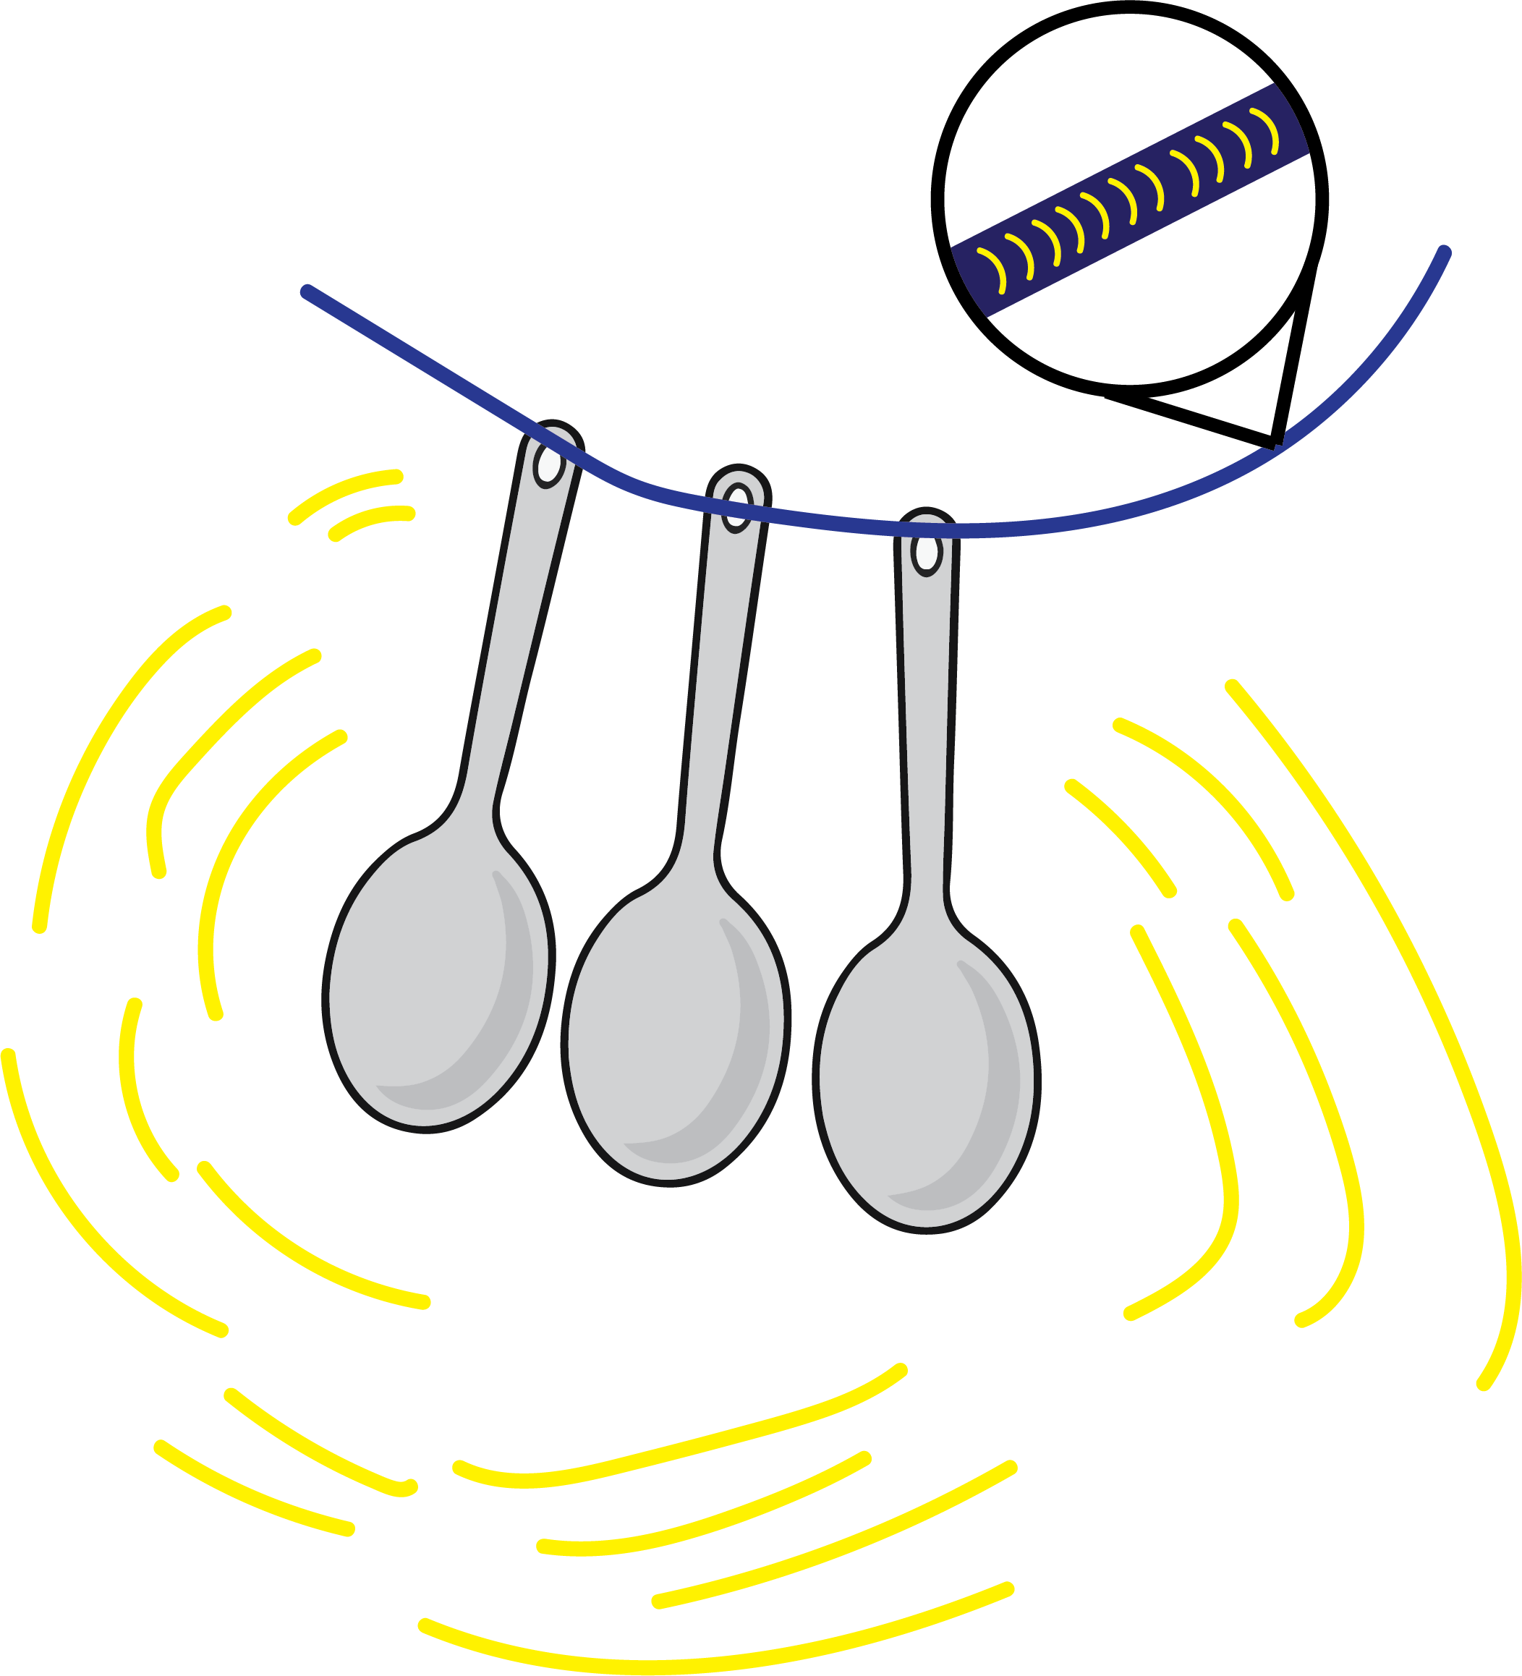
How Does It Work
The spoons’ vibration causes the air molecules to vibrate also, creating soundwaves that moves through the air
When metal spoons knock together, they vibrate (move rapidly back and forth). This makes sound because the vibrations make air molecules vibrate, too, creating invisible waves that travel through the air to your ears. Sound waves spread out as they travel through air, so the sound you hear is tinny. But when you put your fingers in your ears, the vibrations pass through the solid materials (the string, your fingers, and your skull, which houses your inner ears). Sound waves travel more effectively through solids than air because the molecules are more tightly packed together. As a result, you hear a richer, more complex pattern of sound waves.
The spoons vibrate (flexes back and forth very rapidly)
The spoons’ vibration causes the air molecules to vibrate also, creating soundwaves that moves through the air

Slide 10

Real World: Technology
Stethoscope
Normally, your heartbeat is to quiet to hear without any hearing aid. However, a doctor/nurse can hear it with a device called a stethoscope. At one end of this device there is a cup that the doctor presses on your chest to collect a faint sound of the heart beating. On the other end, the is a hollow tube which channels this sound to the doctor’s ears, preventing the sound waves from spreading out in all directions and becoming too faint to hear.

Slide 11
Recap
Sounds we hear are made by waves of vibrations that disturb the air.
We were able to simulate a sound machine by using metal spoons
Although, normally sound travels through the air, it can also travel through solids.
When sound travels through solids, it will give off a high tone compared to sound travelling through air.

